Slide 1

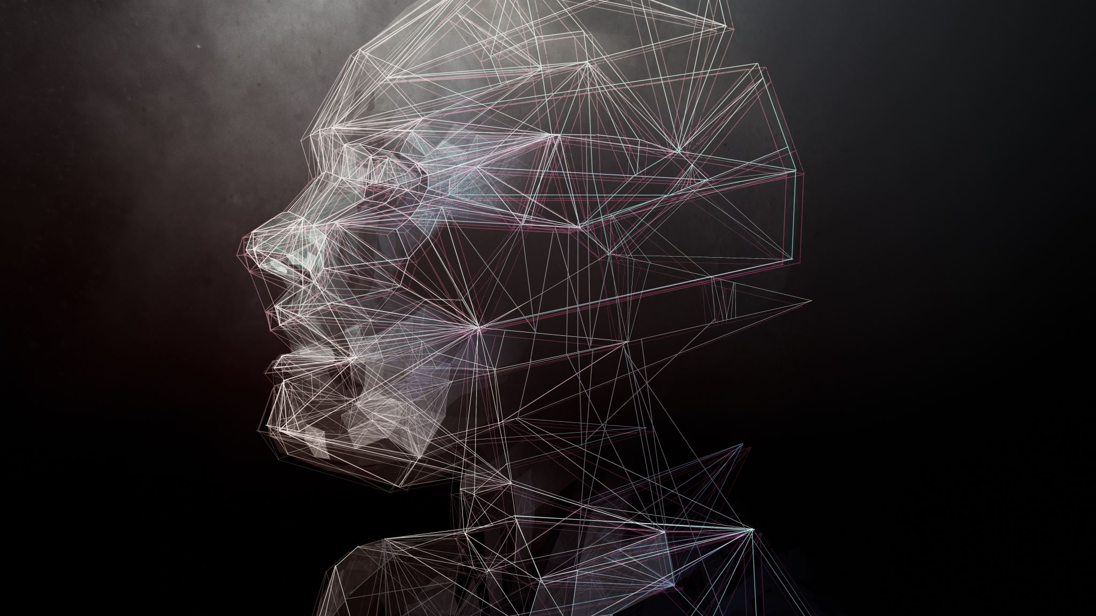

Ai and art
Copyright issues

Slide 2
Outline
Brief History of Image Generating AI’s
Copyright Issues

Slide 3
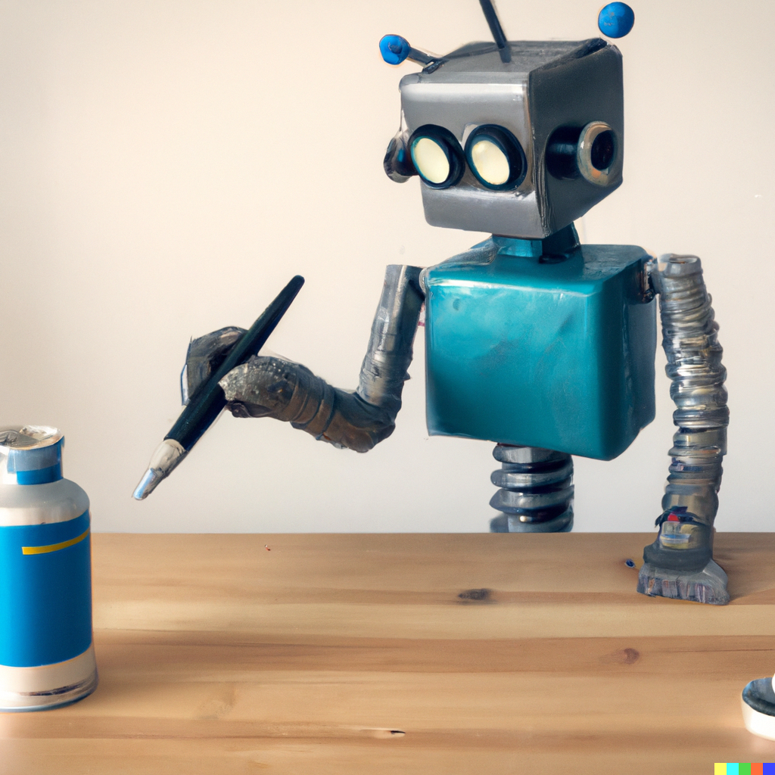
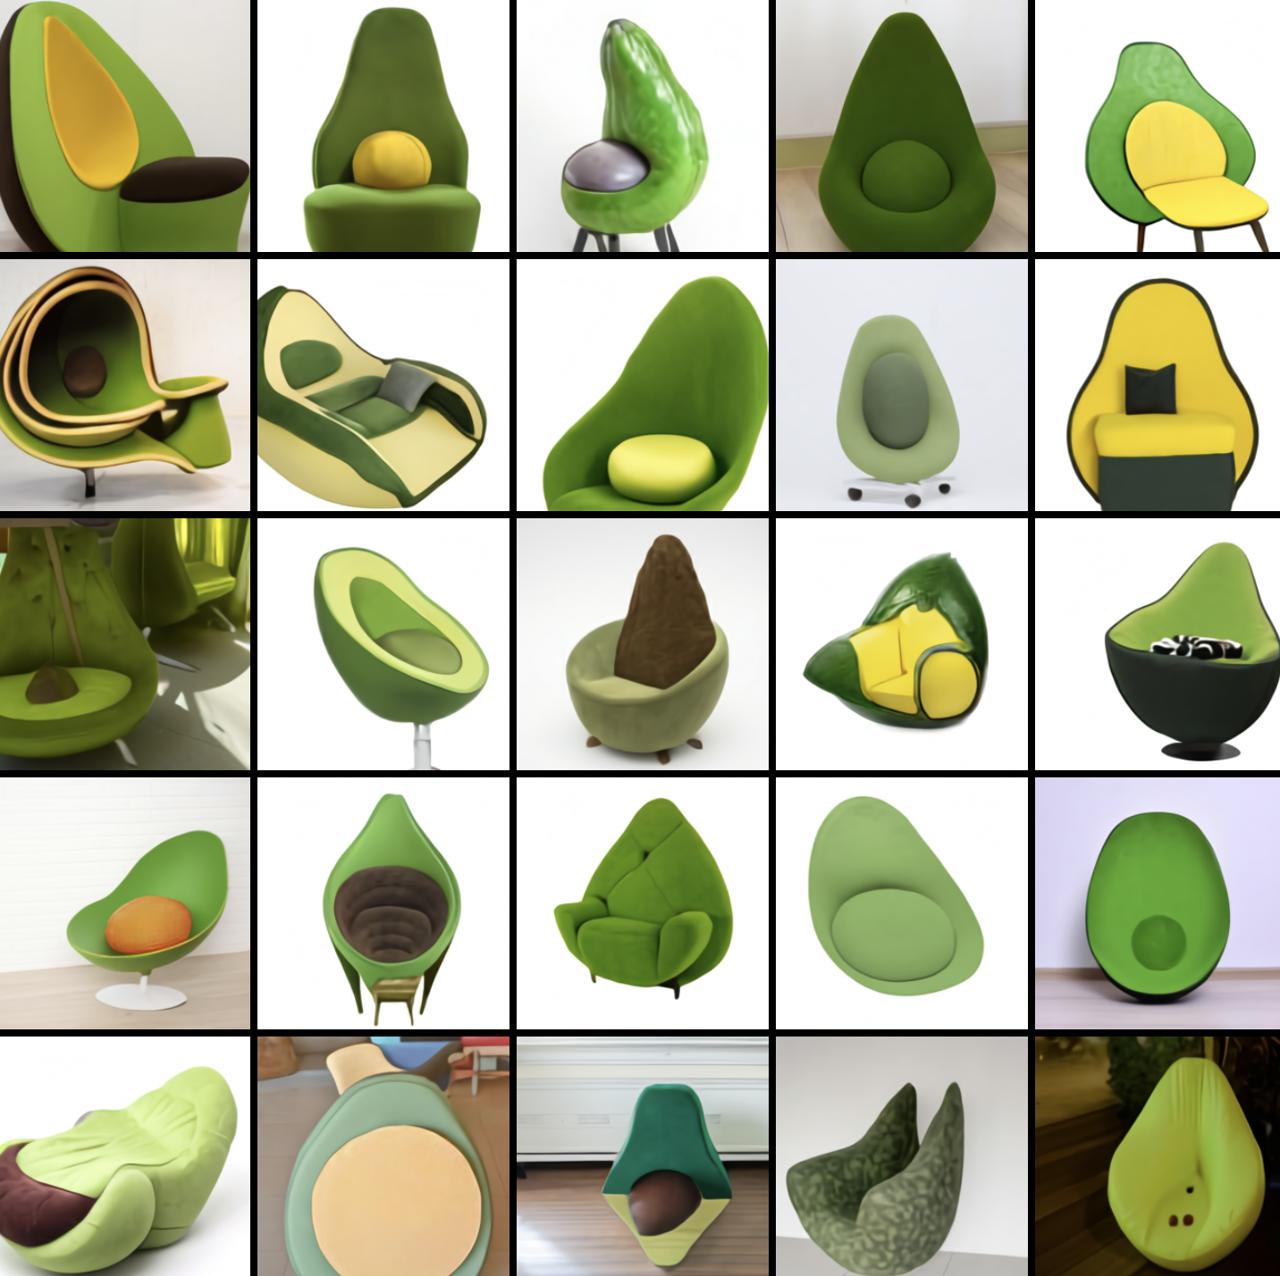
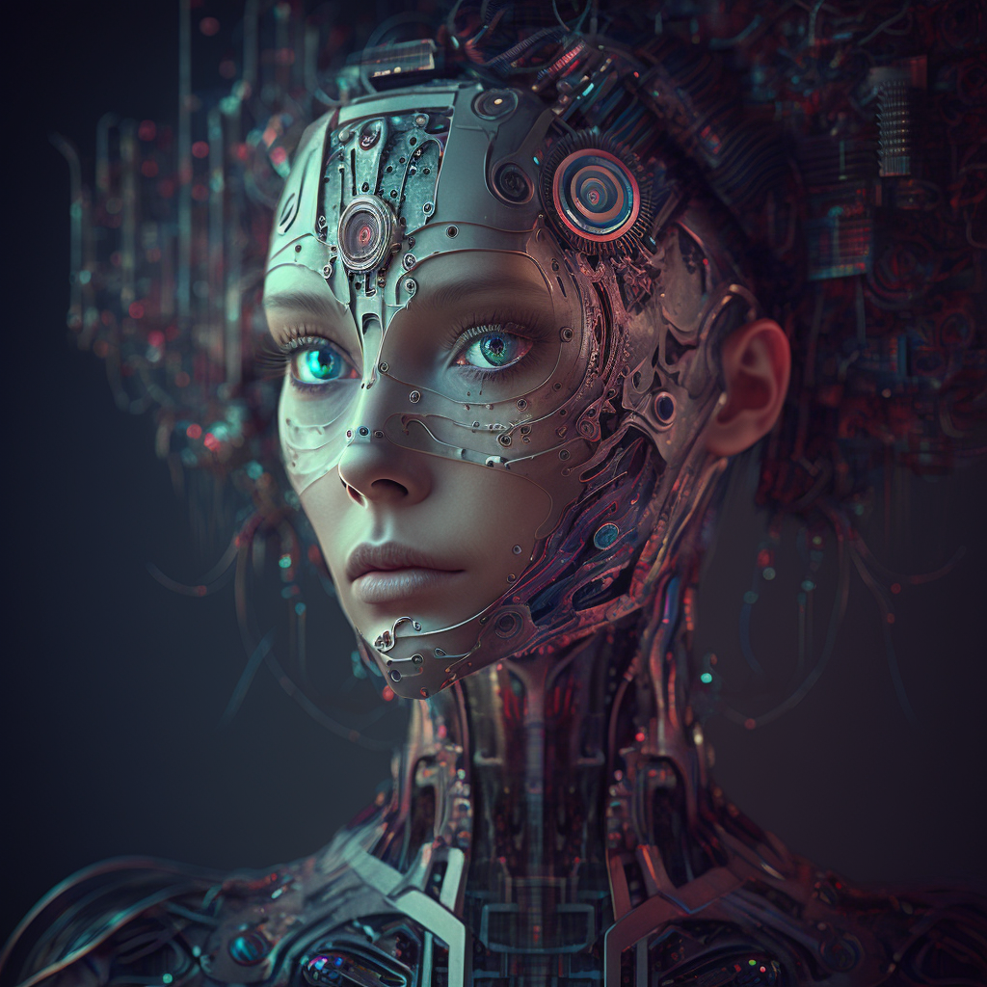
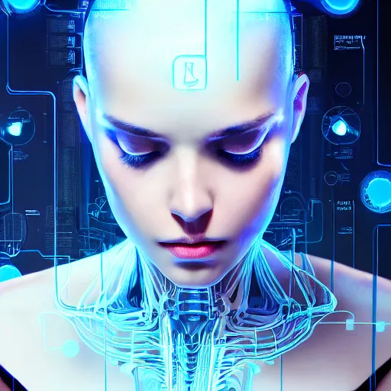
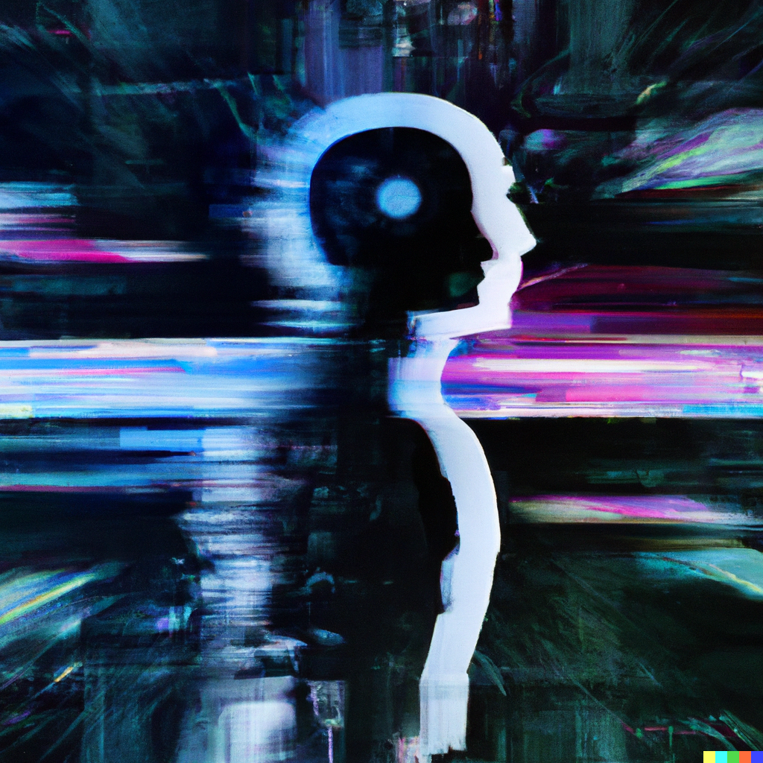
brief history of Image generatiNG ai’s
DALL-E – January 2021
DALL-E 2 – September 2022
Midjourney – July 2022
Stable Diffusion – August 2022
Others

Slide 4
Getty ımages vs stable dıffusıon
Getty Images claims a damage of $2 trillion.
Laws and regulations are not yet ready for the AI age.

Slide 5
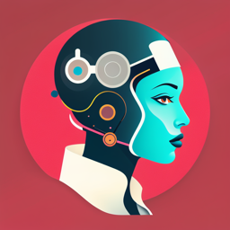
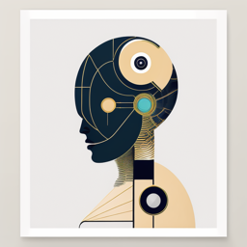
Copyrıght ıssues
Who owns the generated “art”?
Is training an AI, a copyright issue?
Does the generated art cause copyright issues?
If copyright exists, who owns it?

Slide 6
sources
All the images used in this presentation were generated by AI except the slide backgrounds!
https://www.midjourney.com/
https://openai.com/research/dall-e
https://labs.openai.com/ (Is it really a source? ☺)
https://stablediffusionweb.com/prompts
https://www.theartnewspaper.com/2023/03/28/ai-and-art-how-recent-court-cases-are-stretching-copyright-principles
https://hotpot.ai/art-generator

